Slide 1
Exception handling
Pl/sql

Slide 2
Exception and Exception handling
An exception is an error which disrupts the normal flow of program instructions.
An exception occurs when the PL/SQL engine encounters an instruction which it cannot execute due to an error that occurs at run-time.
These errors will not be captured at the time of compilation and hence these needed to be captured and handled only at the run-time- Exception Handling mechanism
PL/SQL provides us the exception block which raises the exception thus helping the programmer to find out the fault and resolve it.
There are two types of exceptions defined in PL/SQL
User defined exception.
System defined exceptions.

Slide 3
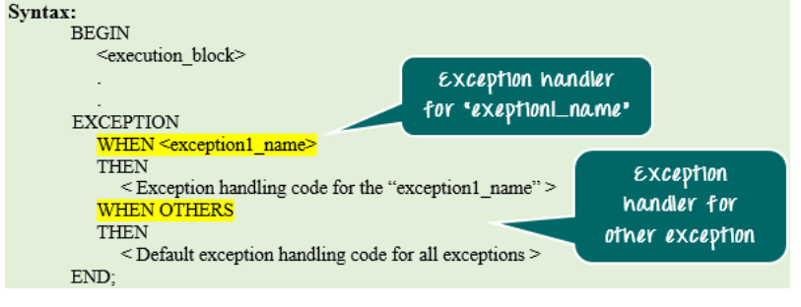
Syntax to write an exception
WHEN exception THEN statement;
DECLARE declarations section;
BEGIN executable command(s);
EXCEPTION WHEN exception1 THEN statement1; WHEN exception2 THEN statement2; [WHEN others THEN] /* default exception handling code */
END;
Note:
When other keyword should be used only at the end of the exception handling block .
No exception handling part present later will get executed as the control will exit from the block after executing the WHEN OTHERS.
Exceptions are handled at the block, level, i.e., once if any exception occurs in any block then the control will come out of execution part of that block.
The exception will then be handled at the exception handling part of that block. After handling the exception, it is not possible to resend control back to the execution section of that block.

Slide 4
In the above syntax, the exception-handling block contains series of WHEN condition to handle the exception.
Each WHEN condition is followed by the exception name which is expected to be raised at the run time.
When any exception is raised at runtime, then the PL/SQL engine will look in the exception handling part for that particular exception. It will start from the first ‘WHEN’ clause and, sequentially it will search.
If it found the exception handling for the exception which has been raised, then it will execute that particular handling code part.
If none of the ‘WHEN’ clause is present for the exception which has been raised, then PL/SQL engine will execute the ‘WHEN OTHERS’ part (if present). This is common for all the exception.
After executing the exception, part control will go out of the current block.
Only one exception part can be executed for a block at run-time. After executing it, the controller will skip the remaining exception handling part and will go out of the current block.

Slide 5
System defined /predefined exceptions
These exceptions are predefined in PL/SQL which get raised WHEN certain database rule is violated.
These exceptions have a unique exception name and error number.
These exceptions are already defined in the ‘STANDARD’ package in Oracle.
In code, we can directly use these predefined exception name to handle them.
System-defined exceptions are further divided into two categories:
Named system exceptions.
Unnamed system exceptions.
Named system exceptions: They have a predefined name by the system like ACCESS_INTO_NULL, DUP_VAL_ON_INDEX, LOGIN_DENIED etc. the list is quite big.

Slide 6
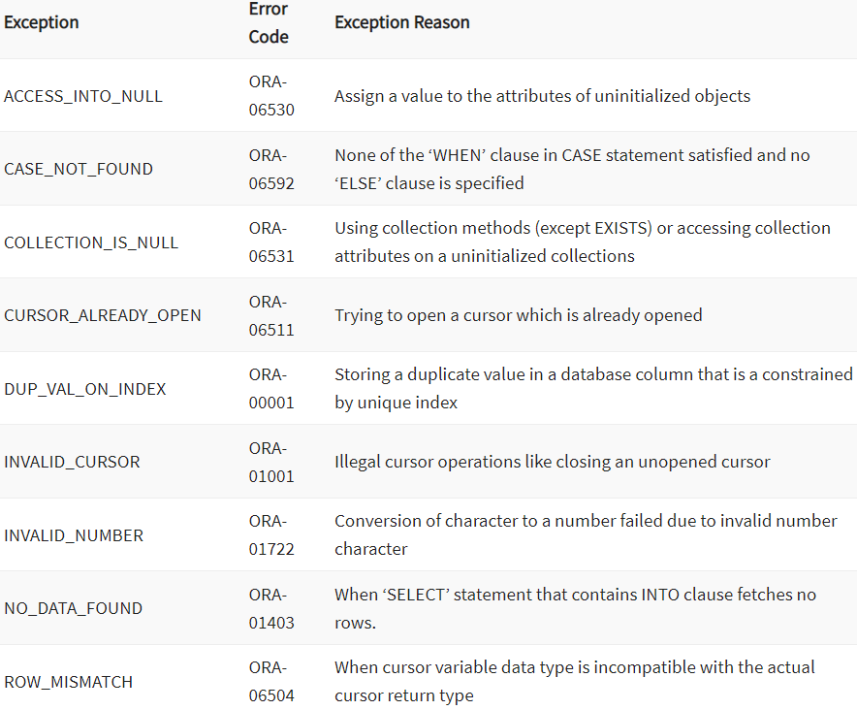

Slide 7
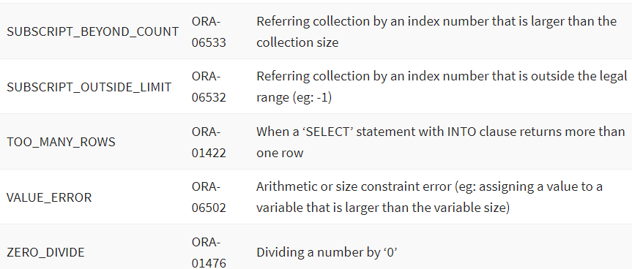

Slide 8
NO_DATA_FOUND: It is raised WHEN a SELECT INTO statement returns no rows. For eg:
DECLARE
temp varchar(20);
BEGIN
SELECT id into temp from customer where name=‘xxx';
exception
WHEN no_data_found THEN
dbms_output.put_line('ERROR');
dbms_output.put_line('there is no name as');
dbms_output.put_line(‘xxx in customer table');
end;

Slide 9
TOO_MANY_ROWS:It is raised WHEN a SELECT INTO statement returns more than one row.
DECLARE
temp varchar(20);
BEGIN
-- raises an exception as SELECT
-- into trying to return too many rows
SELECT name into temp from customer;
dbms_output.put_line(temp);
EXCEPTION
WHEN too_many_rows THEN
dbms_output.put_line('error trying to SELECT too many rows');
end;

Slide 10
VALUE_ERROR:This error is raised WHEN a statement is executed that resulted in an arithmetic, numeric, string, conversion, or constraint error. This error mainly results from programmer error or invalid data input.
DECLARE
temp number;
BEGIN
SELECT name into temp from customer where name='Suraj';
dbms_output.put_line('the name is '||temp);
EXCEPTION
WHEN value_error THEN
dbms_output.put_line('Error');
dbms_output.put_line('Change data type of temp to varchar(20)');
END;

Slide 11
ZERO_DIVIDE = raises exception WHEN dividing with zero.
DECLARE
a int:=10;
b int:=0;
answer int;
BEGIN
answer:=a/b;
dbms_output.put_line('the result after division is'||answer);
exception
WHEN zero_divide THEN
dbms_output.put_line('dividing by zero please check the values again');
dbms_output.put_line('the value of a is '||a);
dbms_output.put_line('the value of b is '||b);
END;

Slide 12
Unnamed system exceptions: Oracle doesn’t provide name for some system exceptions called unnamed system exceptions.
These exceptions don’t occur frequently.T hese exceptions have two parts code and an associated message. The way to handle to these exceptions is to assign name to them using Pragma EXCEPTION_INIT Syntax:
PRAGMA EXCEPTION_INIT(exception_name, -error_number);
error_number are pre-defined and have negative integer range from -20000 to -20999.
DECLARE
exp exception;
pragma exception_init (exp, -20015);
n int:=10;
BEGIN
FOR i IN 1..n LOOP
dbms_output.put_line(i*i);
IF i*i=36 THEN
RAISE exp;
END IF;
END LOOP;
EXCEPTION
WHEN exp THEN
dbms_output.put_line(‘handled unnamed exception');
END;

Slide 13
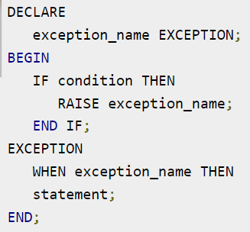
Raising Exceptions
Exceptions are raised by the database server automatically whenever there is any internal database error, but exceptions can be raised explicitly by the programmer by using the command RAISE.
the procedure DBMS_STANDARD.RAISE_APPLICATION_ERROR.

Slide 14
User defined exceptions
This type of users can create their own exceptions according to the need and to raise these exceptions explicitly raise command is used.
Example:
Divide non-negative integer x by y such that the result is greater than or equal to 1.From the given question we can conclude that there exist two exceptions
Division be zero.
If result is greater than or equal to 1 means y is less than or equal to x.

Slide 15
DECLARE
x int:=&x; /*taking value at run time*/
y int:=&y;
div_r float;
exp1 EXCEPTION;
exp2 EXCEPTION;
BEGIN
IF y=0 then
raise exp1;
ELSEIF y > x then
raise exp2;
ELSE
div_r:= x / y;
dbms_output.put_line('the result is '||div_r);
END IF;
EXCEPTION
WHEN exp1 THEN
dbms_output.put_line('Error');
dbms_output.put_line('division by zero not allowed');
WHEN exp2 THEN
dbms_output.put_line('Error');
dbms_output.put_line('y is greater than x please check the input');
END;

Slide 16
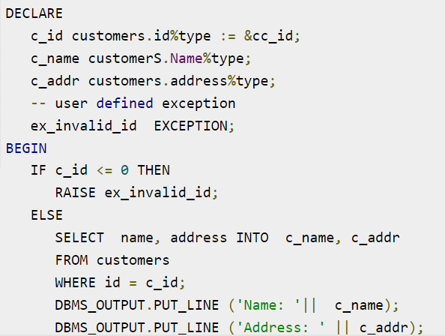
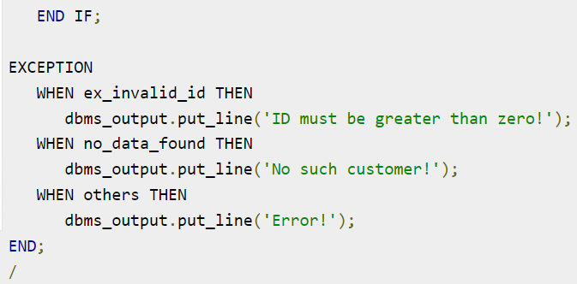

Slide 17
RAISE_APPLICATION_ERROR: It is used to display user-defined error messages with error number whose range is in between -20000 and -20999. When RAISE_APPLICATION_ERROR executes it returns error message and error code which looks same as Oracle built-in error.
DECLARE
myex EXCEPTION;
n NUMBER :=10;
BEGIN
FOR i IN 1..n LOOP
dbms_output.put_line(i*i);
IF i*i=36 THEN
RAISE myex;
END IF;
END LOOP;
EXCEPTION
WHEN myex THEN
RAISE_APPLICATION_ERROR(-20015, 'Welcome to GeeksForGeeks');
END;

Slide 18
Scope rules in exception handling:
We can’t DECLARE an exception twice but we can DECLARE the same exception in two dIFferent blocks.
Exceptions DECLAREd inside a block are local to that block and global to all its sub-blocks.
As a block can reference only local or global exceptions, enclosing blocks cannot reference exceptions DECLAREd in a sub-block. If we reDECLARE a global exception in a sub-block, the local declaration prevails i.e. the scope of local is more.

